Slide 1

Advance PostgreSQL – Part 2

Slide 2
Agenda
Stored Procedure
Functions
Exception Handling
Views
Triggers
Cursor
Full-Text Search
Jobs
Notes:
2

Slide 3
Overview​
Welcome to this session on Advanced PostgreSQL,
PostgreSQL is not just a relational database — it provides powerful server-side programming and automation features that help build scalable, performant, and maintainable applications.
What You’ll Learn
What Stored Procedures & Functions encapsulate logic
How Views simplify complex queries
How Triggers automate database actions
How Cursors process large result sets
How Jobs enable scheduling in PostgreSQL
How Full-Text Search works for fast text querying
Notes:
3

Slide 4
Functions & Stored Procedures
Functions and Stored Procedures allow you to:
Write business logic inside the database
Reduce repetitive SQL in applications
Improve performance and maintainability
Ensure data consistency
They are written using PL/pgSQL or SQL.
Notes:
4

Slide 5
What is PL/pgSQL?
PL/pgSQL Basics
Procedural language for PostgreSQL
Extends SQL with:
  Variables
  Conditions (IF)
  Loops (FOR, WHILE)
  Exception handling
Why PL/pgSQL?
Complex logic
Control flow
Better than plain SQL for logic-heavy tasks
Notes:
5

Slide 6
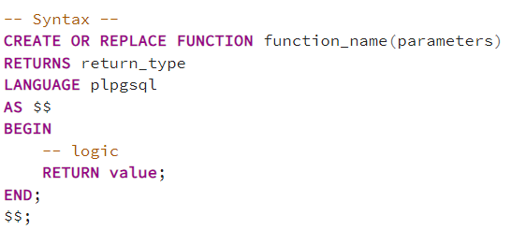
PostgreSQL Function
What is a Function?
A Function:
Always returns a value
Can be used inside:
  SELECT
  WHERE
  JOIN
Is often used for calculations & lookups
  Think of functions like reusable SQL expressions
Can be used inside queries
Lightweight & fast
Ideal for reusable logic
Notes:
6

Slide 7
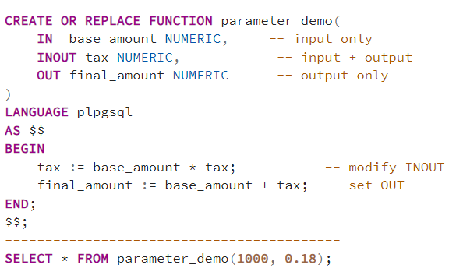
Function Parameters
Parameters
Inputs to a function
Defined in function signature
Can be:
  IN (default)
  OUT
  INOUT
Notes:
7

Slide 8
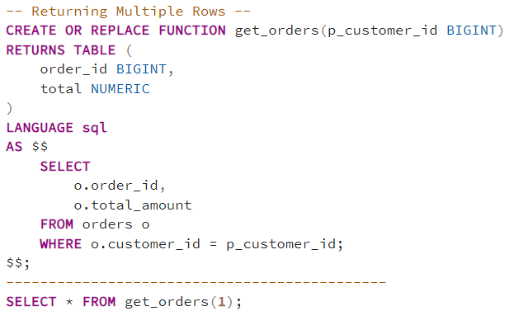
Function Example
Notes:
8

Slide 9
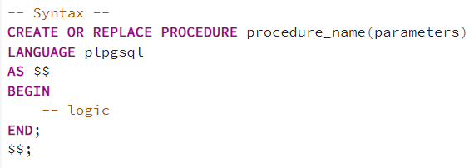
PostgreSQL Stored Procedure
What is a Stored Procedure?
A Stored Procedure:
Does NOT return a value
Is executed using CALL
Can:
  Perform INSERT / UPDATE / DELETE
  Manage transactions
  Execute complex workflows
Used for actions
Cannot be used inside SELECT
Notes:
9

Slide 10
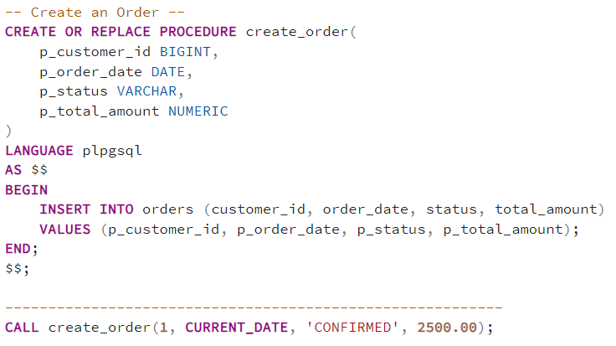
Stored Procedure - Example
Notes:
10

Slide 11
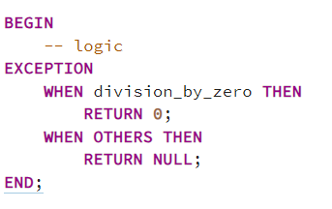
Exception Handling
Why Exception Handling?
Prevent function failure
Handle runtime errors gracefully
Common PostgreSQL Exceptions
division_by_zero
no_data_found
unique_violation
foreign_key_violation
Others
Best Practice
Handle only expected errors
Log or raise others
Notes:
11

Slide 12
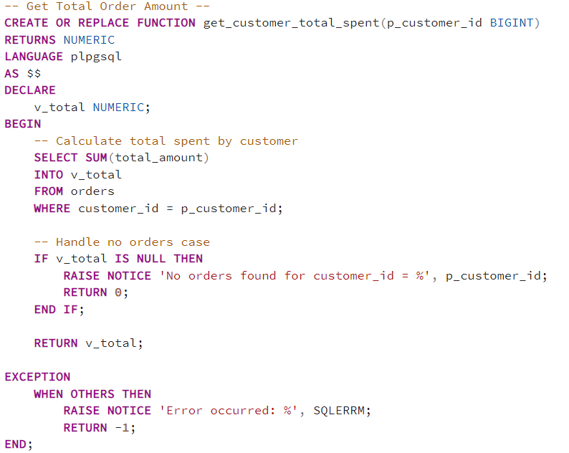
Exception Handling - Example
Notes:
12

Slide 13
Function vs Stored Procedures
Feature | Function | Stored Procedure
Returns value | Yes | No
Used in SELECT | Yes | No
Called using | SELECT | CALL
Transaction control | Limited | Supported
Best for | Calculations, lookups | Business workflows
Notes:
13

Slide 14
When to Use What ?
Use Functions When
You need a return value
Logic is reusable inside queries
You want better query readability
Use Stored Procedures When
You perform multiple DML operations
You manage transactions
You implement business processes
Notes:
14

Slide 15
Views and Materialized Views
Why Views & Materialized Views?
As databases grow:
Queries become complex
Repeated joins reduce readability
Performance tuning becomes harder
Views and Materialized Views help by:
Simplifying complex SQL
Improving reusability
Enhancing performance and security
Notes:
15

Slide 16
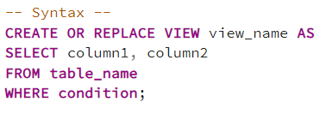
What Is A View?
A View is:
A virtual table
Defined by a stored SELECT query
Does not store data physically
Always shows real-time data
Think of a View as a saved query
Cleaner queries
No repeated joins
Always up-to-date data
Notes:
16

Slide 17
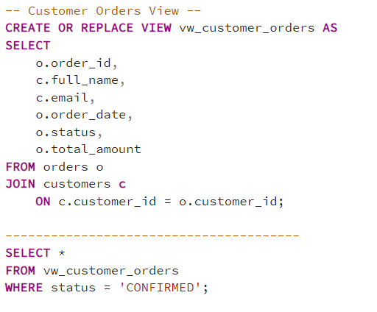
View Example
Notes:
17

Slide 18
Key Takeaways
Why Use Views?
Simplifies complex queries
Improves code reusability
Enhances data security
Centralizes business logic
Reduces application-side SQL
Things to Remember
No physical data storage
Performance depends on underlying tables
Complex views may be slow
Indexes cannot be created directly on views
Notes:
18

Slide 19
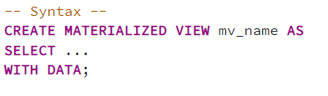
What is Materialized View?
A Materialized View:
Stores query results physically
Improves read performance
Needs manual or scheduled refresh
Uses more storage
Think of it as a cached view
Views simplify and secure data access
Materialized Views improve performance
Choose based on freshness vs speed
Very common interview topic
Notes:
19

Slide 20
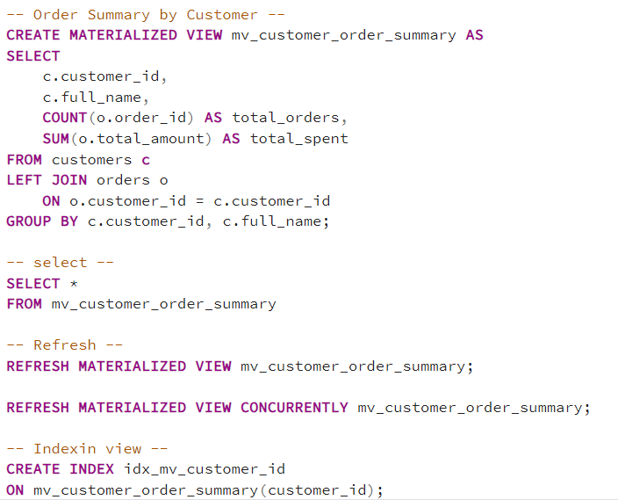
Materialized View Example
Notes:
20

Slide 21
Views vs Materialized Views
Feature | View | Materialized View
Data storage | No | Yes
Data freshness | Real-time | Depends on refresh
Query speed | Slower | Faster
Refresh needed | No | Yes
Index support | No | Yes
Notes:
21

Slide 22
When to Use What ?
Use Views When
Data must be real-time
Queries need simplification
Security & abstraction are needed
Use Materialized Views When
Queries are heavy & slow
Data doesn’t change frequently
Reporting & analytics use cases
Notes:
22

Slide 23
Trigger
A Trigger is a database object that automatically executes a function when a specific event occurs on a table.
Events:
  INSERT
  UPDATE
  DELETE
  TRUNCATE
Timing:
  BEFORE
  AFTER
  INSTEAD OF (views)
Notes:
23

Slide 24
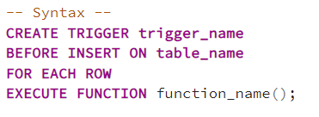
Why Use Triggers?
Enforce business rules
Automatic auditing & logging
Maintain derived data
Data validation
Reduce application logic
- Avoid heavy logic → performance impact
Trigger Components :
Trigger function (PL/pgSQL)
Trigger definition
Event & timing
Target table
Notes:
24

Slide 25
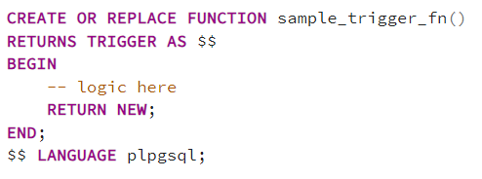
Trigger Function Basics
A special PostgreSQL function that runs automatically
Executes on INSERT / UPDATE / DELETE
Key Rules:
Must return TRIGGER
NEW and OLD records
  NEW → the new row data
    Available in INSERT and UPDATE
  OLD → the existing row data
    Available in UPDATE and DELETE
Notes:
25

Slide 26
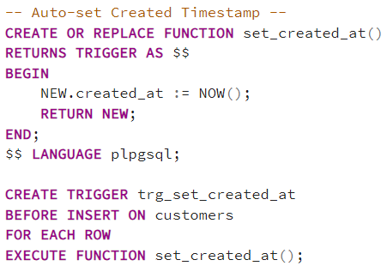
BEFORE INSERT Trigger Example
Modifies data before insert
Notes:
26

Slide 27
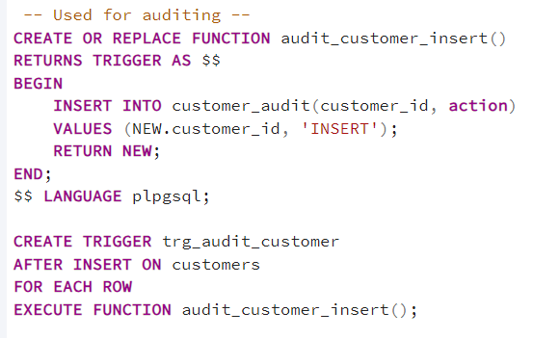
AFTER INSERT Trigger Example
Modifies data after insert
Notes:
27

Slide 28
BEFORE UPDATE Trigger Example
Modifies data after insert
Notes:
28

Slide 29
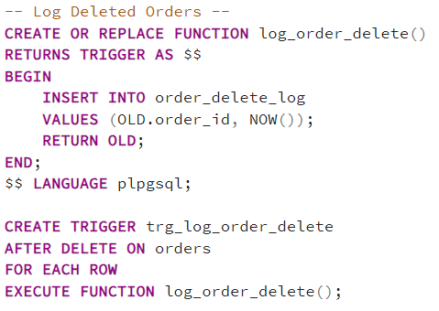
DELETE Trigger Example
Notes:
29

Slide 30
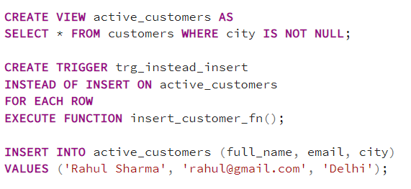
INSTEAD OF Triggers
Notes:
30

Slide 31
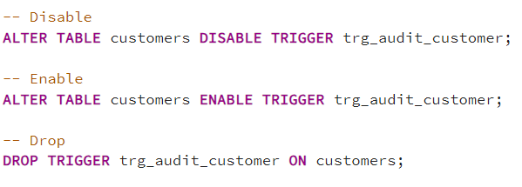
Disable / Enable / Drop Trigger
Notes:
31

Slide 32
Best Practices for Trigger
Keep triggers lightweight
Avoid cascading triggers
Prefer constraints when possible
Document trigger behavior
Test with bulk operations
When NOT to Use Triggers
Heavy business logic
Cross-table complex logic
Hidden side effects
Performance-critical paths
Notes:
32

Slide 33
PostgreSQL Cursor
A cursor allows you to process query results row-by-row instead of loading the entire result set into memory at once.
User in:
Stored procedures / functions
Batch processing
Large data migrations
pgAgent jobs (inside DO blocks or procedures)
Syntax:
DECLARE cursor_name CURSOR FOR query;
OPEN cursor_name;
FETCH cursor_name INTO variable;
CLOSE cursor_name;
Notes:
33

Slide 34
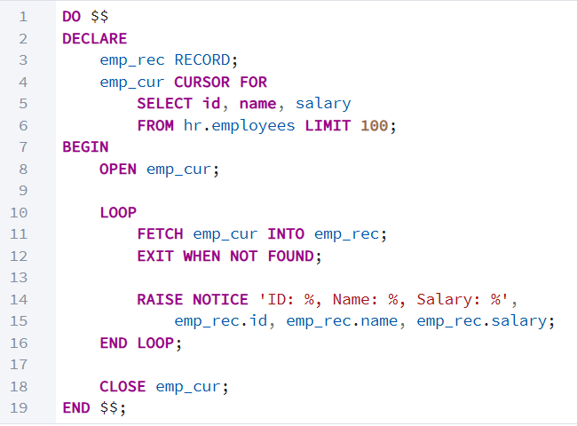
Example of Cursor
Basic Cursor (OPEN → FETCH → CLOSE)
Notes:
34

Slide 35
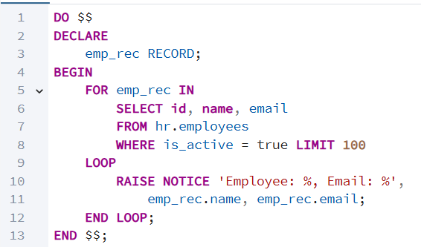
Example of Cursor
Cursor Using FOR LOOP
Notes:
35

Slide 36
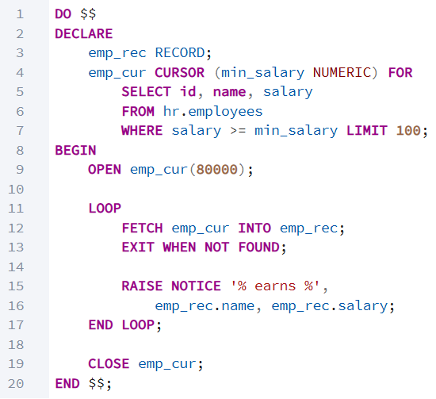
Example of Cursor
Parameterized Cursor
Notes:
36

Slide 37
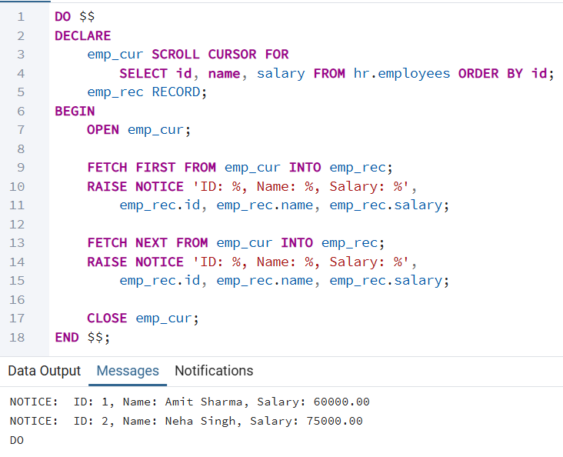
Example of Cursor
Scrollable Cursor
Notes:
37

Slide 38
Full Text Search(FTS)
Full-Text Search (FTS) allows searching natural language text efficiently.
Searches by meaning, not just patterns
Handles word forms (run, running, ran)
Ignores stop words (the, is, a)
Supports ranking & relevance
Used for:
Product search
Blog/article search
E-commerce filters
Log & document search
Notes:
38

Slide 39

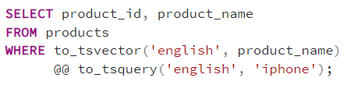
Why NOT LIKE / ILIKE?
Slow on large datasets (full table scan)
No relevance ranking
No linguistic understanding (just string matching)
Poor scalability
Why Full-Text Search (FTS)?
Uses indexes → fast queries
Ranks results by relevance
Language-aware (stemming, stop words)
Built for search at scale
Notes:
39

Slide 40
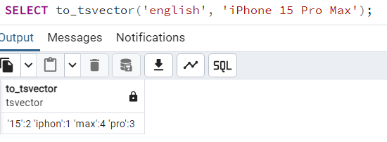
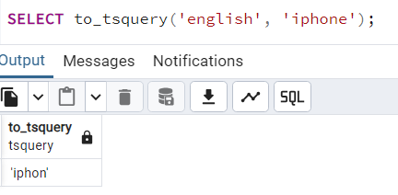
FTS : Core Concepts
tsvector
Processed searchable document
Normalized & tokenized text
tsquery
Search query representation
Notes:
40

Slide 41
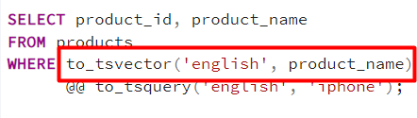
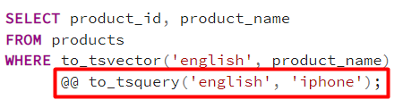
How FTS Works
Document Processing
  Text is converted into tsvector
  Words are:
    Lowercased
    Stemmed (phones -> phone)
    Stop words removed (the, is, a)
2. Query Processing
  Search input becomes a tsquery
  Supports:
    AND (&)
    OR (|)
    Phrase & prefix search
Notes:
41

Slide 42
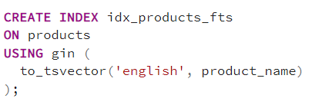
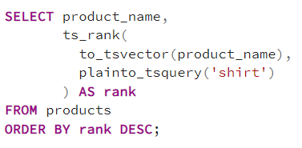
How FTS Works
3. Indexing
  GI or GiST index on tsvector
  Enable fast lookup (no table scan)
4. Search + Ranking
  Matches document using @@
  Results ranked by relevance (ts_rank)
Notes:
42

Slide 43
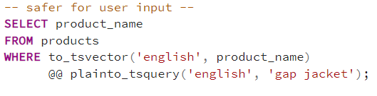
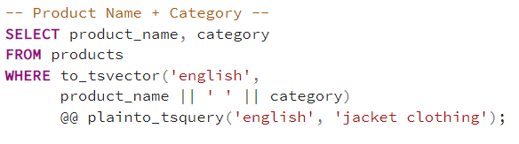
FTS - Examples
Using plainto_tsquery
Searching Multiple Columns
Notes:
43

Slide 44
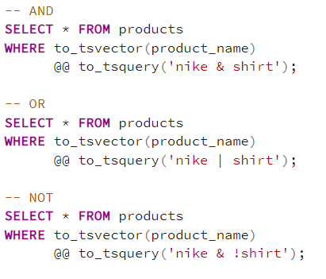
FTS - Examples
AND, OR, NOT in search
Notes:
44

Slide 45
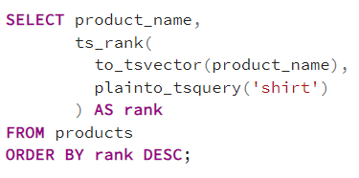
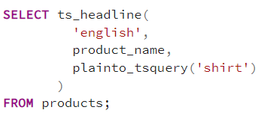
FTS - Examples
Ranking Search Results
Highlighting Matched Text
Notes:
45

Slide 46
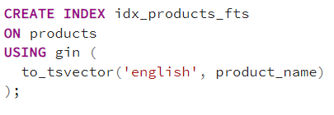
Full-Text Search Index
Performance Problem Without Index
Each search recalculates to_tsvector
Slow on millions of rows
Creating Full-Text Search Index
Notes:
46

Slide 47
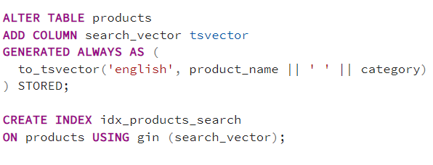
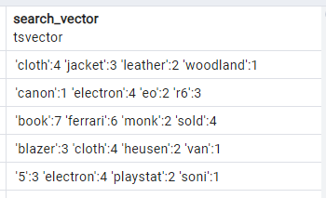
Using Generated Columns
Notes:
47

Slide 48
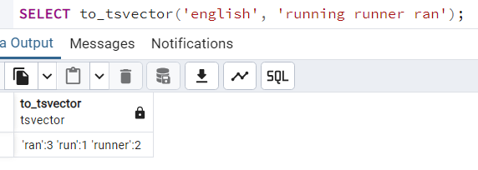
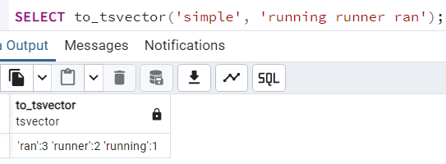
Languages and Dictionaries
PostgreSQL supports multiple languages
  Use english for stemming
  Use simple for exact words
Notes:
48

Slide 49
When to Use Full-Text Search
Large text data
Search boxes
E-commerce products
Blogs & articles
Logs & descriptions
Not for exact matches (use =)
Notes:
49

Slide 50
Jobs (Scheduling)
Why Do We Need Jobs?
Databases often require recurring tasks, such as:
Data cleanup
Report generation
Refreshing materialized views
Archiving old records
Jobs allow PostgreSQL to:
Execute tasks automatically
Run SQL on a schedule
Reduce manual intervention
Notes:
50

Slide 51
How PostgreSQL Handles Jobs
PostgreSQL does NOT have a built-in job scheduler like SQL Server.
Instead, it uses:
pg_cron (most popular)
pgAgent (pgAdmin)
pg_cron Overview
PostgreSQL extension
Runs SQL jobs inside the database
Uses cron syntax
Supports one-time & recurring jobs
Notes:
51

Slide 52
Jobs – pg_cron
pg_cron is a PostgreSQL extension that lets you run scheduled jobs (cron jobs) directly inside PostgreSQL, similar to Linux cron, but managed via SQL.
What is pg_cron?
pg_cron allows you to:
Schedule SQL commands
Schedule stored procedures / functions
Run jobs at fixed intervals (minute, hourly, daily, weekly, etc.)
Runs inside PostgreSQL
Jobs are stored in DB tables
Uses standard cron syntax
Notes:
52

Slide 53
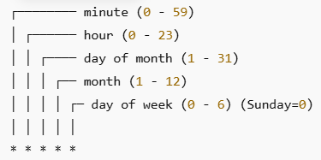
Jobs – pg_cron
How to install and create a job?
CREATE EXTENSION pg_cron;
SELECT cron.schedule( 'run-every-minute', '* * * * *', 'INSERT INTO logs(job_name, run_at) VALUES (''test'', now())' );
SELECT cron.schedule('daily-cleanup-midnight', '0 0 * * *', 'DELETE FROM audit_logs WHERE created_at < now() - interval ''90 days''');
SELECT cron.schedule('recalculate-stats', '0 */6 * * *', 'CALL
recalc_driver_statistics();');
Notes:
53

Slide 54
Jobs – pg_cron
Requirement | Cron Expression
Every minute | * * * * *
Every 5 minutes | */5 * * * *
Every 15 minutes | */15 * * * *
Every hour | 0 * * * *
Every 6 hours | 0 */6 * * *
Twice a day (2 AM & 2 PM) | 0 2,14 * * *
Requirement | Cron Expression
Daily at midnight | 0 0 * * *
Daily at 1:30 AM | 30 1 * * *
Daily at 10 PM | 0 22 * * *
Daily at noon | 0 12 * * *
Notes:
54

Slide 55
Jobs – pg_cron
Requirement | Cron Expression
Every Sunday at midnight | 0 0 * * 0
Every Monday at 9 AM | 0 9 * * 1
Weekdays (Mon–Fri) at 10 AM | 0 10 * * 1-5
Requirement | Cron Expression
1st of every month at midnight | 0 0 1 * *
15th of every month at 2 AM | 0 2 15 * *
End of month (approx) | 0 0 28-31 * *
Notes:
55

Slide 56
Jobs – pgAgent
pgAgent is a job scheduling agent for PostgreSQL, allowing you to automate tasks like running SQL scripts or shell commands on complex schedules, and is managed via pgAdmin. It functions as a daemon/service, often on the database server, and provides a robust framework for scheduling recurring or one-off tasks with features like dependencies and execution logs, distinguishing it from simpler schedulers like pg_cron.
Installation: Install pgAgent as a separate package (often via StackBuilder, apt, or yum) and ensure the necessary PostgreSQL extensions (plpgsql, pgagent) are enabled.
Configuration: Define jobs with one or more steps (e.g., SQL Script`, Shell Script) and set up schedules (frequency, start/end dates) in pgAdmin.
Execution: pgAgent runs as a background process, executing scheduled jobs according to your defined schedules and step
Notes:
56

Slide 57
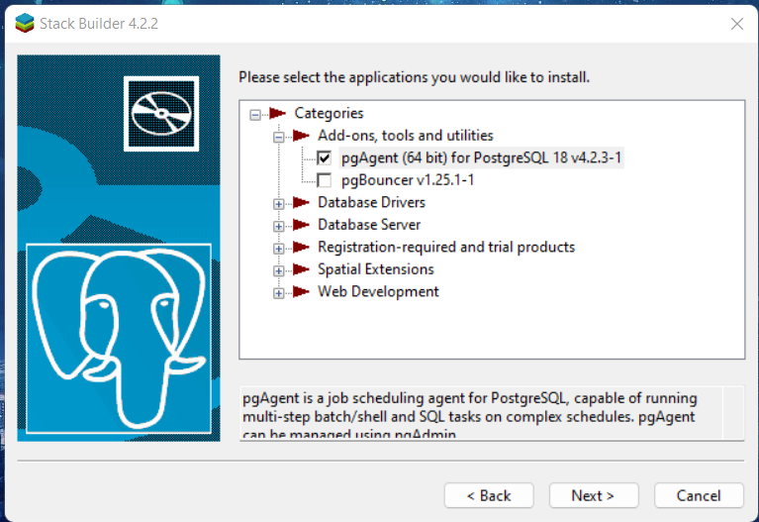
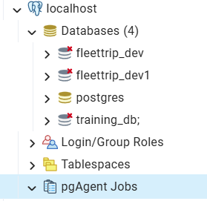
Jobs – pgAgent
Installation:
Notes:
57

Slide 58
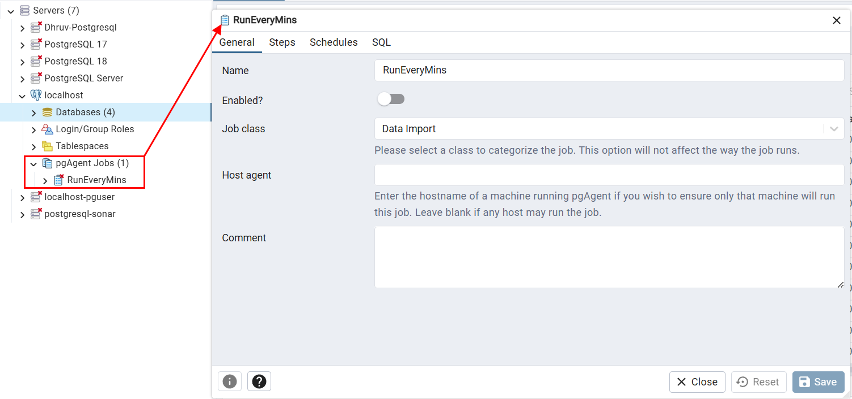
Jobs – pgAgent
Create a Job:
Notes:
58

Slide 59
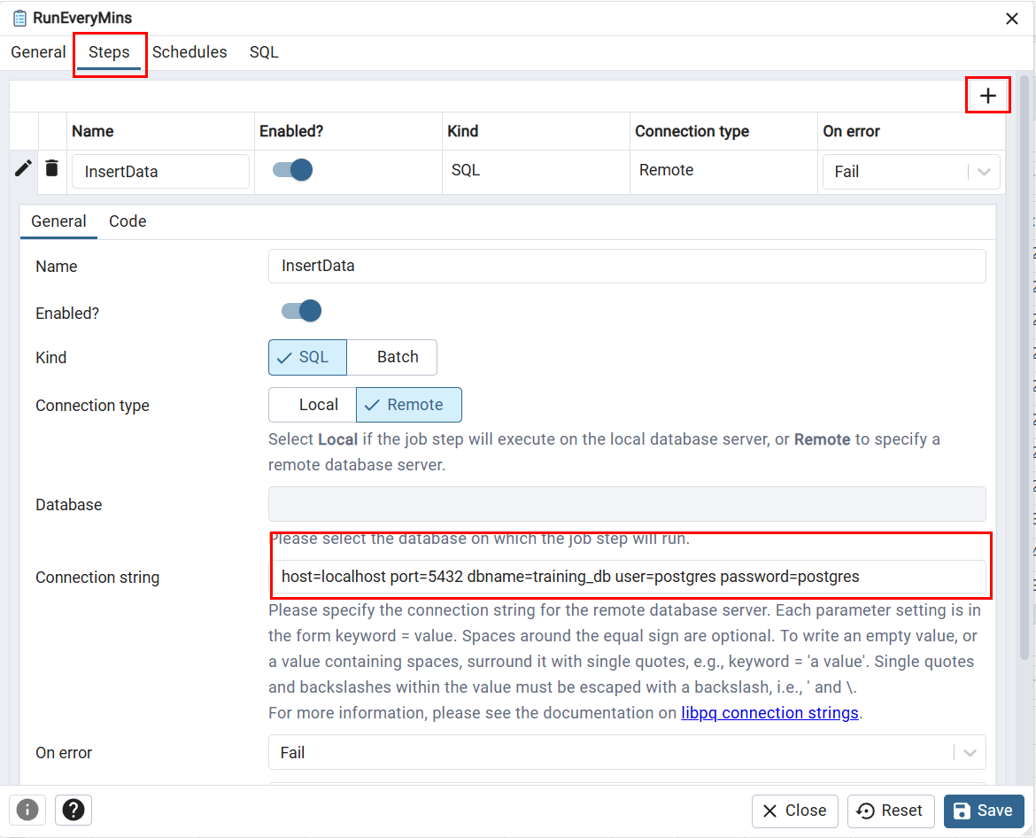
Jobs – pgAgent
Create a Job Steps:
Notes:
59

Slide 60
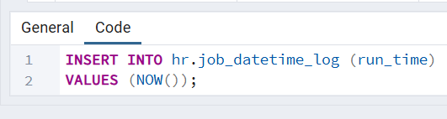
Jobs – pgAgent
Create a Job Steps:
Notes:
60

Slide 61
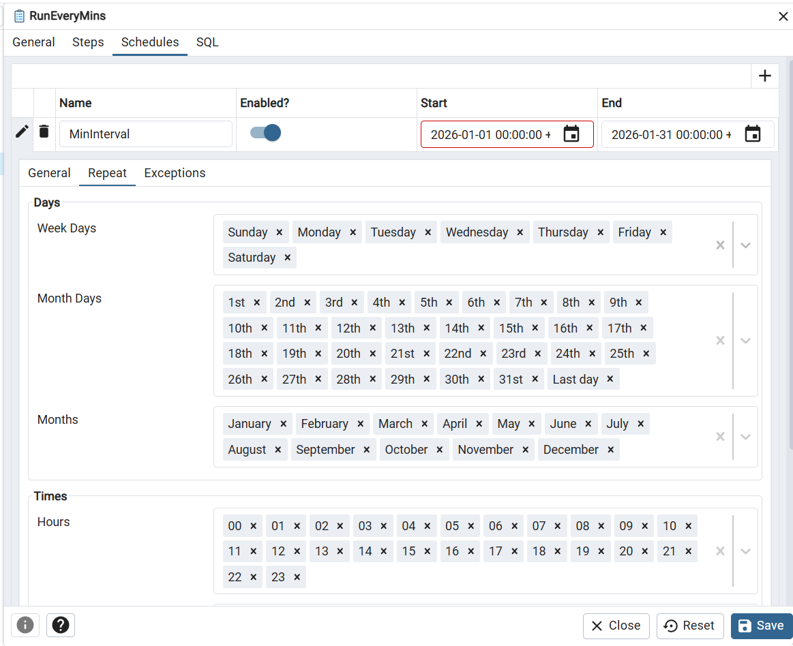
Jobs – pgAgent
Create a Job Schedule:
Notes:
61

Slide 62
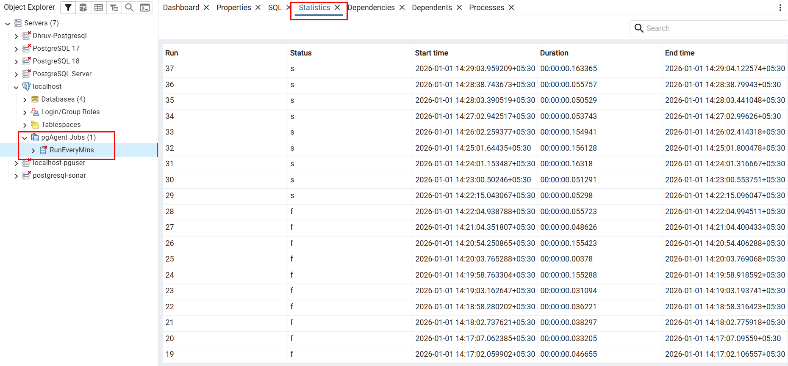
Jobs – pgAgent
Job Statistics:
Notes:
62

Slide 63
THANK YOU
ANY QUESTIONS ?
Notes:
63

